Slide 1

RESTAURANT
MANAGEMENT SYSTEM
USING PYTHON

Slide 2

01
02
INCREASE THE SALES WITH THE INVOLVEMENT OF AI
REDUCING THE AMOUNT OF PROBLEMS FACED DURING CONSUMER PROVIDER INTERFACE
03
04
AIMING TO SAVE MORE TIME AND PAPER
CUSTOMER CAN MENTION THEIR VALUABLE SUGGESTIONS AND CAN RATE
OBJECTIVES

Slide 3

THE IDEA
THE PROJECT TO BE SERVED CONSISTS OF A BILLING MANAGEMENT SYSTEM THROUGH WHICH THE BILL CAN BE DIRECTLY SENT TO THE CUSTOMER’S MOBILE NUMBER THROUGH API, WHERE THEY CAN ALSO GIVE THEIR VALUABLE SUGGESTIONS.

Slide 4

SYSTEMS USED:
PYTHON - Python is an interpreted, high-level and general-purpose programming language. Python's design philosophy emphasizes code readability with its notable use of significant whitespace.
TKINTER PACKAGE - Tkinter is a standard GUI toolkit through which general layout of the software is created.

Slide 5
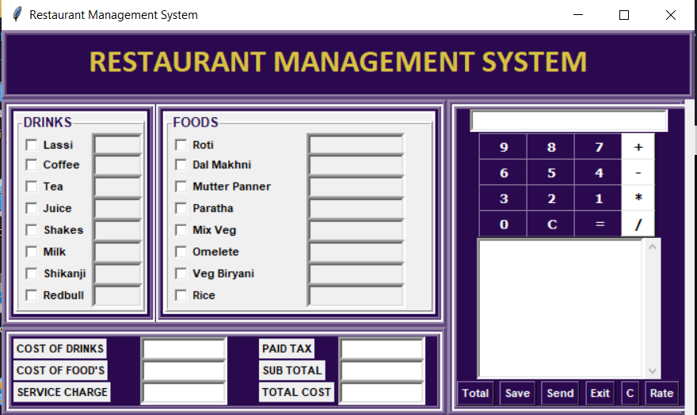
MAIN PROGRAM
THIS IS THE MAIN PROGRAM OF OUR SOFTWARE WHICH CONSISTS OF:
THE MAIN MENU- Where the costumer can easily select according to their taste buds and quantity.
A CALCULATOR- Keeping in mind the extra calculations.
DIFFERENT COMMANDS
THE BILLING AREA

Slide 6
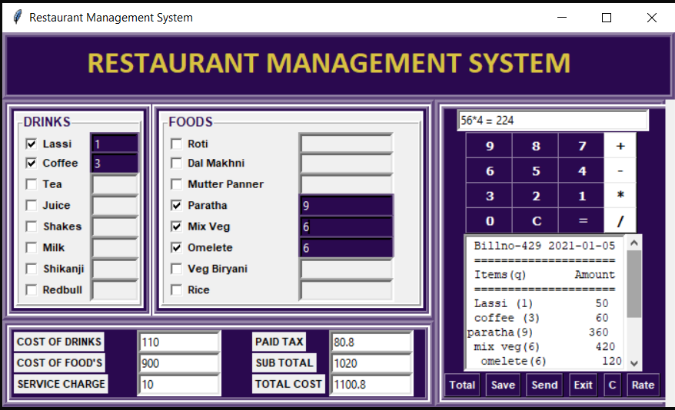
THIS IS THE REPRESENTATION OF HOW OUR BILL GETS GENERATED AND HOW THE COMMANDS ARE USED TO KEEP THE WORK GOING ON

Slide 7
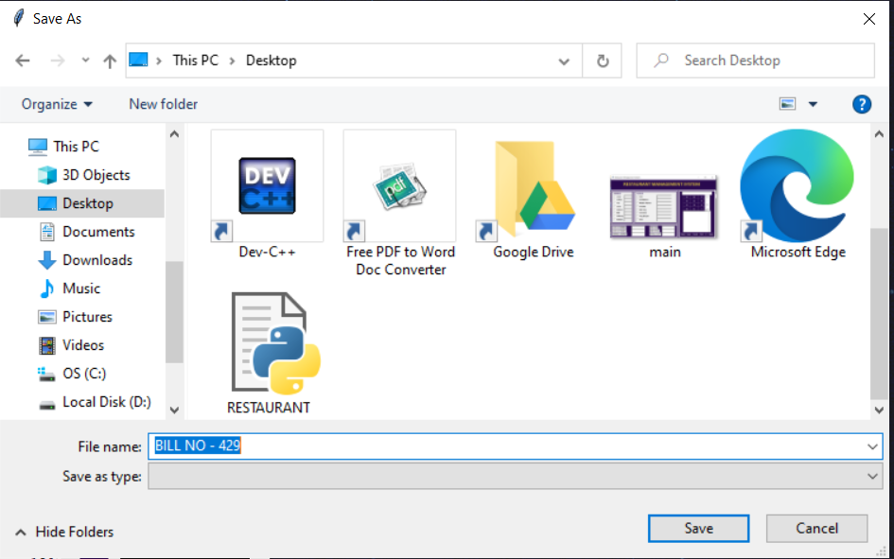
SAVING THE BILL
THE BILL CAN BE AUTOMATICALLY/MANUALLY FURTHER SAVED FOR THE FUTURE REFERENCE.

Slide 8
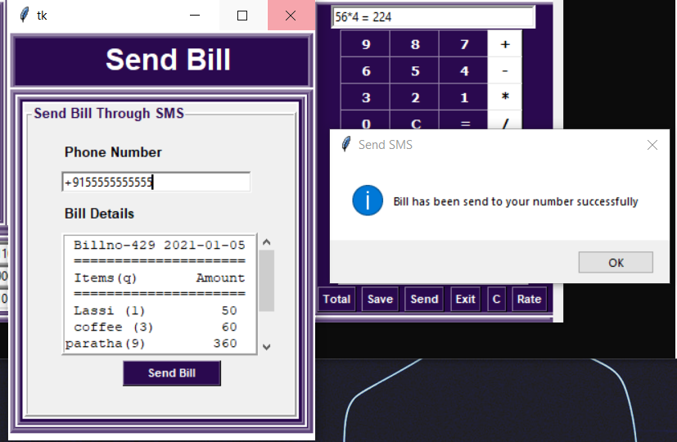
SENDING THE BILL
NOW THE GENERATED BILL CAN BE FURTHER SENT TO THE CUSTOMER’S MOBILE NUMBER WITH BILL NUMBER AND DATE, FOR THEIR PERSONAL REFERENCE.

Slide 9
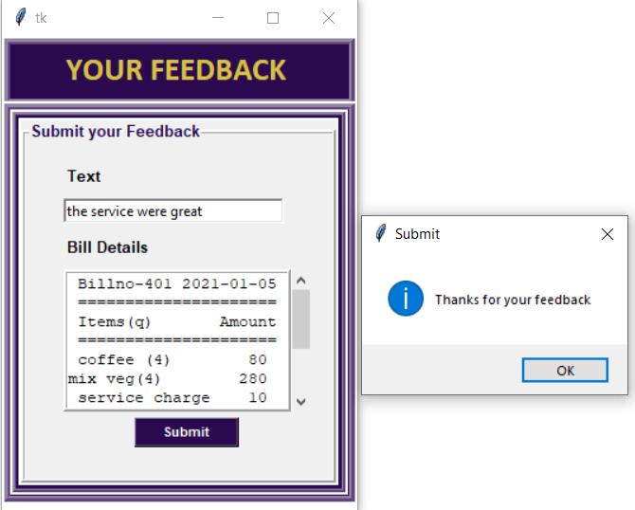
FEEDBACKS
AS FEEDBACKS ARE PRECIOUS :)

Slide 10

TO EXIT
IF A COSTUMER FURTHER WANTS TO EXIT OR CLEAR THE BILL WITHOUT SAVING/SENDING IT, IT CAN BE DONE WITH THE ‘C’ AND ‘EXIT’ COMMAND.

Slide 11

THANK YOU!

